Slide 1
Your Challenge =
Your Opportunity
New York Press Association
Saratoga Springs, NY
March 26, 2010

Slide 2
Who We Are
p 2
Notes:
2

Slide 3
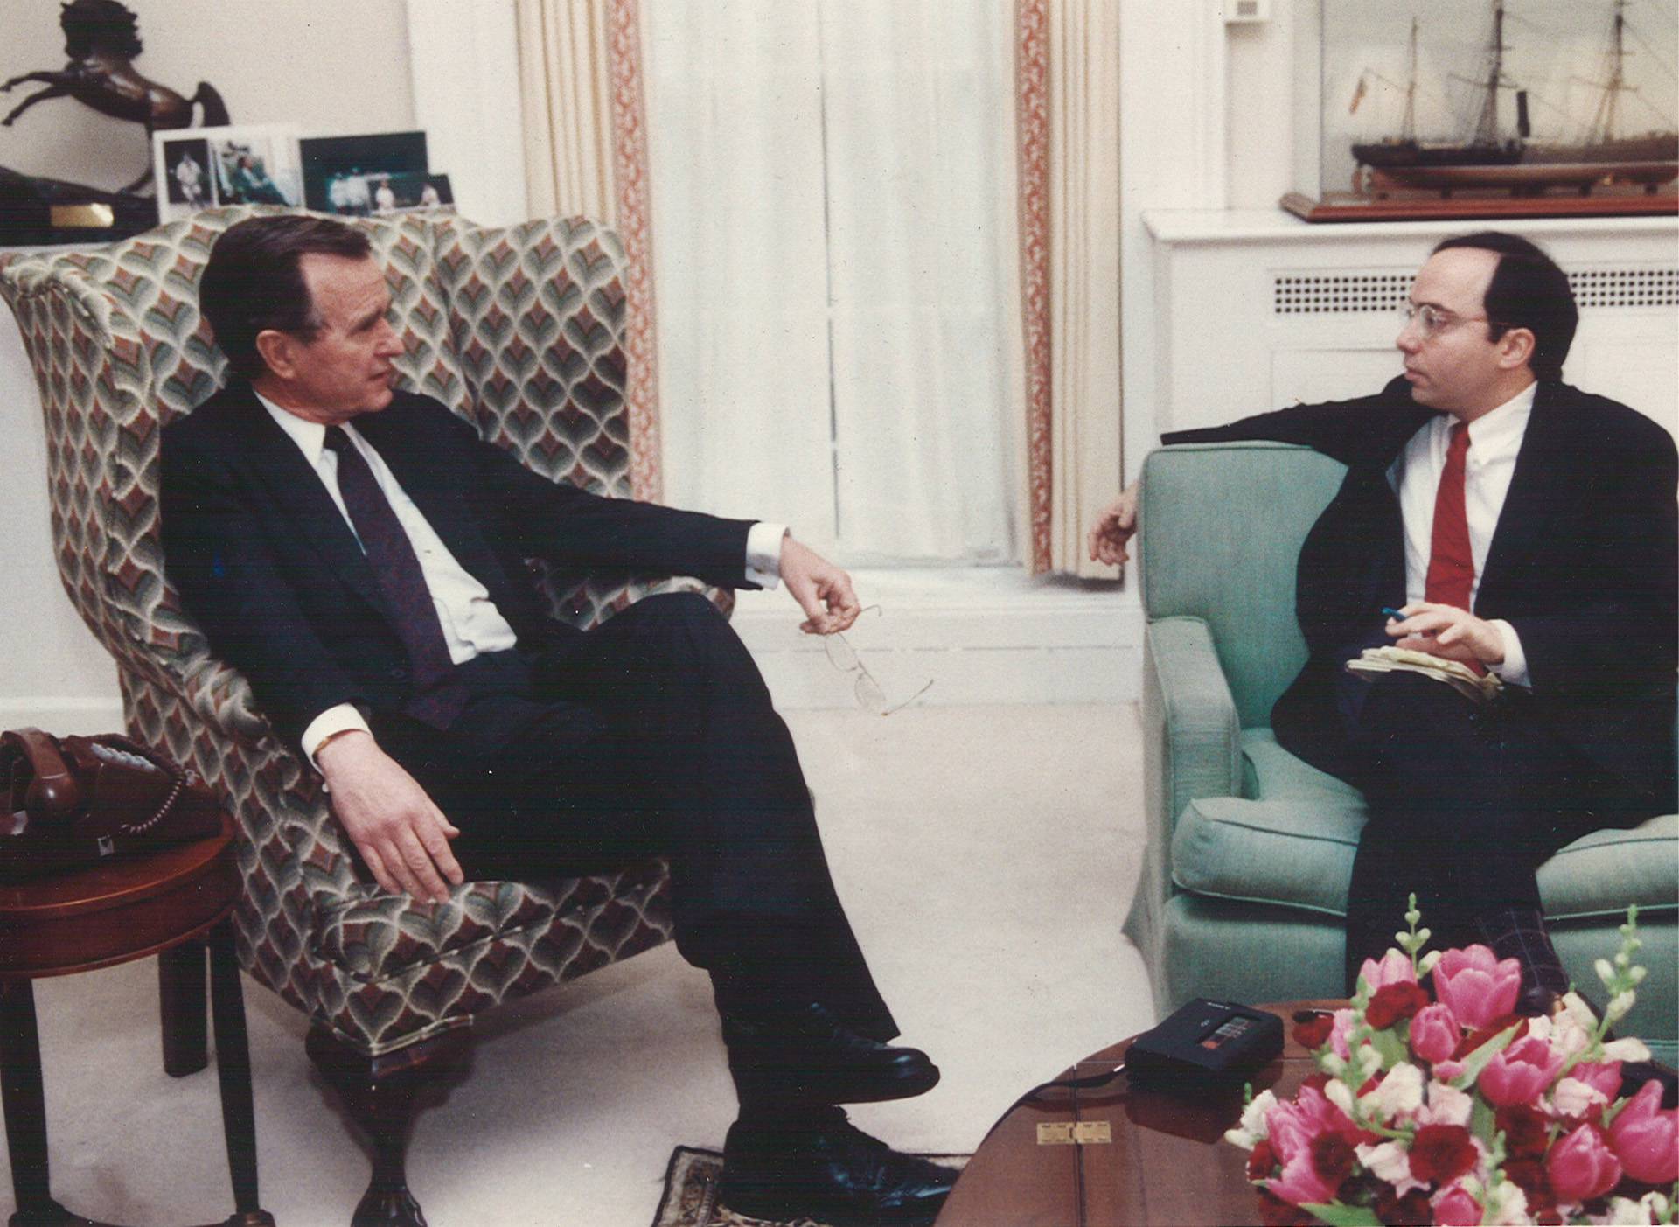
I Am A Working Journalist

Slide 4









































IAB’s ~400 Members Represent 86% of U.S. Interactive Ad Spend

Slide 5
IAB’s Focused Mission…
The Interactive Advertising Bureau is dedicated to the growth of the interactive advertising marketplace, of interactive’s share of total marketing spend, and of our members’ share of total marketing spend.
GROWTH

Slide 6
… Rests on Three Strategic Platforms
Engagement
Showcase to CMOs, agencies, and other marketing influencers interactive media’s unique ability to develop and deliver compelling, relevant communications to the right audiences in the right context.
Accountability
Establish guidelines and highlight practices that reinforce interactive advertising’s unique ability to target and measure audiences
Operational Effectiveness
Improve members’ ability to serve their customers – and build the value of their businesses – by reducing the structural friction within and between media companies and advertising buyers.

Slide 7
Interactive Advertising Snapshot
p 7
Notes:
7

Slide 8
2010 Themes
Recession has hastened share shift from offline to online, as marketers tap into the variety, reach, targetability, and effectiveness of interactive media
Increasing marketer comfort and agility with medium generally and major platforms specifically
Regulatory risks growing

Slide 9
Average Weekly Hours Online
Your Consumers Are Online
Source: USC Annenberg School Center for the Digital Future, The 2009 Digital Future Report, and previous Digital Future Report releases.
p 9
Notes:
9

Slide 10
Drivers of Internet Growth Include: Ubiquity of Broadband…
74%
60%
Source: Pew Internet & American Life Project, Internet, Broadband, and Cell Phone Statistics, Jan. 5, 2010
p 10

Slide 11
… Mainstreaming of Digital Video…
US Monthly Video Streams Served
(Billions)
18%
52%
Key November 2009 Data (Nielsen):
Streams Served: 11.2 billion
Unique Viewers: 138.4 million
Streams/Viewer: 80.8streams
Time per Viewer: 200.1 minutes
Source: “Nielsen: 9.5B Video Streams in November,” NewTeeVee.com, Dec. 30, 2008; “Nielsen Online's VideoCensus: Networks Failing To Reach Men Online,” MediaPost Onlline Media Daily, Feb. 15, 2008; Nielsen VideoCensus Summary Report, Nov. 2009.
p 11
Notes:
11

Slide 12
… Growth of Social Media…
US Audience for Top 10 Social Networking Sites, December 2009
Monthly US Unique Visitors (in Millions)
Total Social Media Audience: 162M, or 79% reach of total US Internet audience
Audience growth leaders include Facebook (105% from Dec. 08-Dec 09); Betawave (401% growth); Twitter (921% growth)
Source: comScore myMetrix, December 2009
p 12
Notes:
12

Slide 13
…And Rise of the Mobile Web
Source: eMarketer, October 2009
p 13

Slide 14
Ad Spend Lags Consumer Adoption
$30 billion
opportunity
Time spent vs. ad spend for major media types (2009)
Time spent
Ad spend
39%
31%
28%
28%
26%
16%
13%
12%
13%
9%
Print
Radio
TV
Online
Sources: Time spent is per NA Technographics (2009); Ad spend is per VSS (2009 Mid-Term Update); Opportunity is Yahoo! estimate.
Notes:
TALKING POINTS: Let’s start with some key market trends—that highlight the growth potential facing Yahoo!
Online Advertising Has Huge Online Growth Potential
Build 1:
Time spent = > Online 2nd only to TV
Build 2:
Ad spend => Down on print, radio and TV –Up online
Ad spend should track audience trends
Build 3:
Online Ad Spend is tracking Time Spent
Build 4:
It’s a $30B opportunity
14

Slide 15
...But Online Share Is Shift Speeding Up
Interactive Advertising Revenues, ‘08 vs. ‘09 (Jan. – June)
-5.3%
(-$600m)
$ Billions
Total ad spend declined 15.4% in 1H 2009 from 2008 (Nielsen);
TNS estimates a 14.3% decline.
Source: IAB Internet Advertising Revenue Report, 2009 Second Quarter and First Six Months Results; Nielsen and TNS Press Releases
Notes:
Speaker Notes:
Strong Year-over-Year growth

Slide 16
The Local Opportunity
p 16
Notes:
16

Slide 17
Local Advertising Is a Vast Market
$245B US Ad Spend
All Media
Local represents 42% of Total Ad Spend
Borrell Associates, November 2009 & Yahoo!
Notes:
17

Slide 18
Interactive Is a Sales-Driving Medium
Category Share of Total Internet Advertising Spending
Source: IAB Internet Advertising Revenue Report, 2009

Slide 19
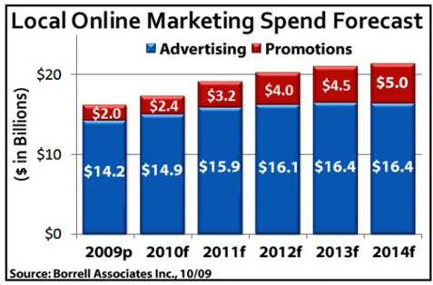
Local Online Outlook: +32%

Slide 20
There Are Untapped Opportunities
-39%
-42%
© 2009 Borrell Associates Inc. All Rights Reserved. Courtesy Yahoo!

Slide 21
Local Newspapers Have a Claim to This Goldmine
p 21
Notes:
21

Slide 22
Because Your Brands Are Strong
100+ million adult weekday readers
114+ million adult Sunday readers
75+ million unique Web site visitors
Reach: 74% of adults in print or online during average week
Source: Scarborough Research, R1 2009 & NAA
Notes:
Reiterate that the newspaper challenge is a business model challenge, not an audience challenge
Declines of less than 2%
79% of adults employed in white collar positions read a newspaper in print or online
82% of adults with household incomes of $100,000 or more read a printed newspaper in print or online
84% of adults who are college graduates or who have advanced degrees read a printed newspaper in print or online
Nearly 139 million adults read a newspaper in print or online in the last week

Slide 23
Because You Drive Sales & Consideration
Clipped a Coupon 61%
Visited a Store 52%
Bought Something Advertised 50%
Picked up Shopping Ideas 34%
Visited a Website to Learn More 33%
Tried Something for the First Time 27%
Used Search for More Information from Print Ad 21%
Bought Something Online 20%
Called for More Information 12%
Source: MORI Research & NAA
Notes:
And newspapers continue to be effective at moving consumers to action, particularly in driving visits to local stores and actually driving them to purchase.

Slide 24
Because Your Advertising Works
Primary medium for consumers who shop ads
Best for bringing sales to attention
Most valuable for planning shopping
Prefer for receiving ad information
Spend most time reading
Most believable and trustworthy
Look forward to these type of ads
Find to be least intrusive
Source: MORI Research & NAA
Notes:
Research also continues to confirm the effectiveness of newspapers as an advertising vehicle. Recent research from MORI demonstrates that newspapers top all other media as a resource for shoppers, who seek out ads in newspapers, unlike most other media.

Slide 25
Because Your Web Sites Are Trusted
Please indicate the website on which you consider the advertising to be the most trustworthy:
Preliminary Results
All 18-24
Local newspaper site 36% 35%
Local TV station site 23% 22%
Online portal 12% 11%
Specialty website 12% 13%
Local radio site 6% 9%
Social networking site 3% 5%
Source: ComScore & NAA
Base: Adults who say type of Web site influences advertising trustworthiness (40%)
Notes:
We are finalizing a study with ComsCore to explore the contextual relevance of ads on newspaper Web sites vs. other sites, building on OPA research to show that ads on quality content sites outperform portals and other sites.
Results show that consumers do trust ads on newspaper Web sites more than other sites and, interestingly, younger users value ads on newspaper Web sites even more than respondents generally.

Slide 26
The Path Forward: Innovation
p 26
Notes:
26

Slide 27


































Network for Strength
Regional Group
51% of all U.S. Sunday circulation
45 media holding companies
821 local newspapers
Notes:
This Value Proposition continues to resonate
As the number of newspapers continue to grow.
Two newest – St. Petersburg Times and The Boston Globe.
And, as you know, there are others that we are in active discussions with and I wouldn’t be surprised that this slide is a lot more crowded when next time we meet.
27

Slide 28

Alliance for Content
350K+ Contributors
Who are our Contributors?
Individuals: pro, semi-pro or amateur content creators
Select media groups interested in revenue and distribution
What do they do?
Publish unique content assets on any topic, in any format
2.0MM+ unique content assets submitted
Publish > 10,000 new pieces content weekly
Create content on topics of their choice or, according to programming assignments
Analytics-Driven Tech Platform
Proprietary yield-management system analyzes 20 most important content-value indicators
Real-time performance metrics of every content variable for lifespan of each content asset
Custom engineered tools for content curation, collection, management, presentation and distribution
Patent-pending technology algorithmically appraisals, real-time valuations of content, creators and topics
2.0MM+ Large, Profitable Library
Professional, semi-professional and UGC media
75% text, 25% video, slideshows and audio
Reactive and proactively programmed content – Assignment Desk
Every asset is reviewed algorithmically, anti-plagiarism screen and by a human being
Optimized for search and social networking distribution
Media companies now distributing content through and from AC

Slide 29



Empower Bloggers & Go Hyperlocal

Slide 30
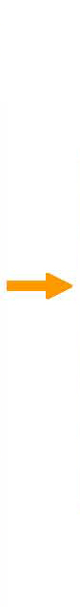

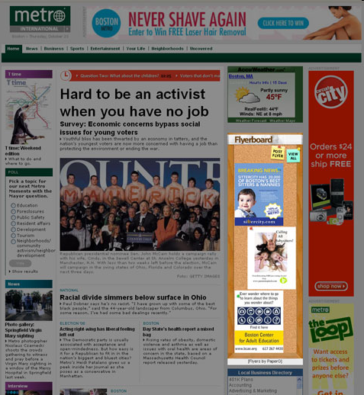
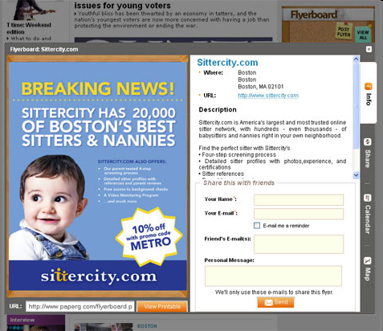
Make Online Advertising Easy
Flyerboard enables the easy creation of online ads for local businesses.

Slide 31
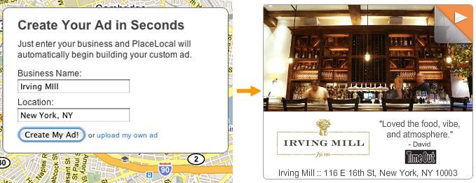
Make Online Advertising Easy
PlaceLocal by PaperG takes any business name and address and automatically builds digital ads for the local business.
Flyerboard enables the easy creation of online ads for local businesses.

Slide 32

Ultra-Serve Your Customers

Slide 33

Make Service Social

Slide 34

Strengthen Community Bonds

Slide 35

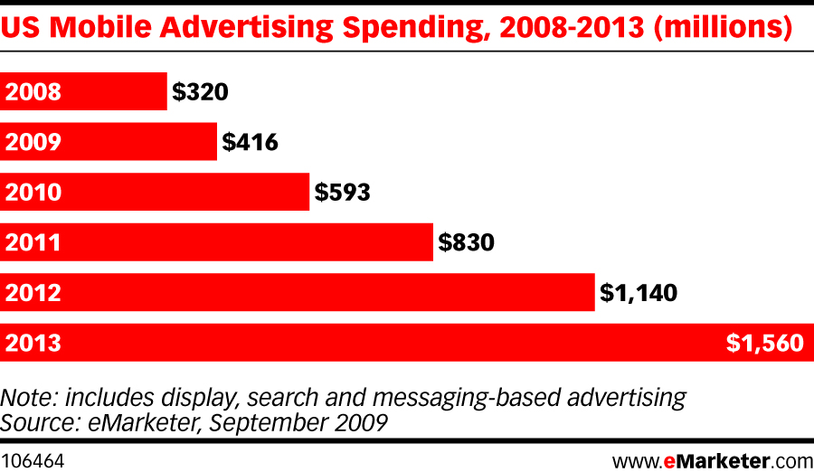

Develop a Mobile App-etite
Notes:
This Value Proposition continues to resonate
As the number of newspapers continue to grow.
Two newest – St. Petersburg Times and The Boston Globe.
And, as you know, there are others that we are in active discussions with and I wouldn’t be surprised that this slide is a lot more crowded when next time we meet.
35

Slide 36
Your Challenge Is Your Opportunity
Network for strength
Alliance for content
Empower bloggers & go hyperlocal
Make online advertising easy
Make service social
Strengthen community bonds
Develop a mobile appetite

