Slide 1


CAPITAL BOND DEVELOPMENT
PROJECTED CONSTRUCTION AND FINANCIAL SCHEDULES
Rye City School District Board of Education Meeting December 11, 2018
Dr. Eric Byrne Gabriella OConnor

Slide 2
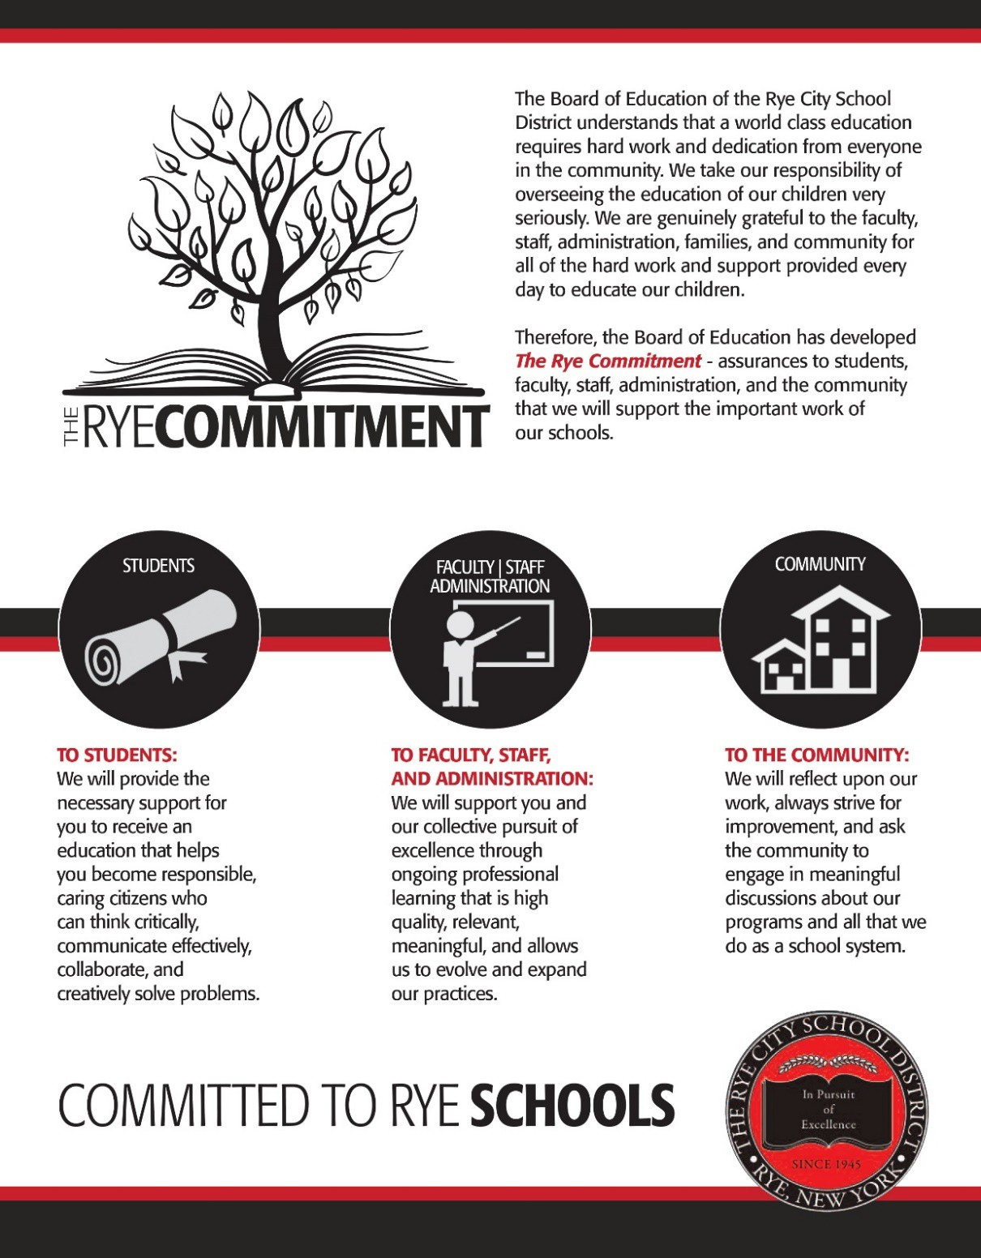
We believe…

Slide 3
RYE CITY SCHOOL DISTRICT BOND PROPOSITION
Capital Projects (includes RHS Athletic Field)
$41,142,597
Bond Proposition
$79,990,000
Building Condition Survey (includes A/C in select spaces)
$38,847,403
The District is currently engaged in the process of determining if participation in an Energy Performance Contract is viable

Slide 4
PROJECTED BORROWING SCHEDULE
June 2020
June 2022
$13,271,710
$54,612,654
$78,069,654
$29,672,307
$79,927,654
2.35% Interest Rate
2.30-3.45% Interest Rate
3.45% Interest Rate
2.40% Interest Rate
2.50% Interest Rate
June 2019
June 2021
June 2023
Amounts represent cumulative annual borrowing totals (includes principal payments made)

Slide 5

DISTRICT DEBT PAYMENT OBLIGATION
Year |  | Existing Debt Expense | + | Projected New Debt Expense | = | Projected Total Debt Expense |  | Projected Annual Change in Debt Expense | Projected Annual Change in Tax Rate /$1,000 of Assessment
2019 |  | $ 3,871,950 |  | $ - |  | $ 3,871,950
2020 |  | $ 3,756,885 |  | $ 130,000 |  | $ 3,886,885 |  | $ 14,935 | $ 0.12
2021 |  | $ 2,952,875 |  | $ 966,241 |  | $ 3,919,116 |  | $ 32,231 | $ 0.25
2022 |  | $ 2,870,875 |  | $ 1,051,051 |  | $ 3,921,926 |  | $ 2,809 | $ 0.02
2023 |  | $ 2,802,525 |  | $ 1,783,733 |  | $ 4,586,258 |  | $ 664,332 | $ 5.21
2024 |  | $ 1,581,125 |  | $ 3,642,143 |  | $ 5,223,268 |  | $ 637,010 | $ 5.00
2025 |  | $ 1,572,600 |  | $ 4,255,625 |  | $ 5,828,225 |  | $ 604,958 | $ 4.75
2026 |  | $ 1,550,050 |  | $ 4,304,325 |  | $ 5,854,375 |  | $ 26,150 | $ 0.21
2027 |  | $ 1,546,200 |  | $ 4,328,025 |  | $ 5,874,225 |  | $ 19,850 | $ 0.16
2028 |  | $ 1,522,950 |  | $ 4,381,725 |  | $ 5,904,675 |  | $ 30,450 | $ 0.24
2029 |  | $ 1,060,650 |  | $ 4,730,263 |  | $ 5,790,913 |  | $ (113,763) | $ (0.89)
2030 |  | $ 1,058,200 |  | $ 4,728,800 |  | $ 5,787,000 |  | $ (3,913) | $ (0.03)
2031 |  | $ 1,060,000 |  | $ 4,732,338 |  | $ 5,792,338 |  | $ 5,338 | $ 0.04
2032 |  | $ 1,060,900 |  | $ 4,730,713 |  | $ 5,791,613 |  | $ (725) | $ (0.01)
2033 |  | $ 1,060,900 |  | $ 4,729,088 |  | $ 5,789,988 |  | $ (1,625) | $ (0.01)
2034 |  | $ - |  | $ 4,732,463 |  | $ 4,732,463 |  | $ (1,057,525) | $ (8.30)
2035 |  | $ - |  | $ 4,730,675 |  | $ 4,730,675 |  | $ (1,788) | $ (0.01)
2036 |  | $ - |  | $ 4,728,888 |  | $ 4,728,888 |  | $ (1,788) | $ (0.01)
2037 |  | $ - |  | $ 4,732,100 |  | $ 4,732,100 |  | $ 3,213 | $ 0.03
2038 |  | $ - |  | $ 4,730,150 |  | $ 4,730,150 |  | $ (1,950) | $ (0.02)
2039 |  | $ - |  | $ 4,728,200 |  | $ 4,728,200 |  | $ (1,950) | $ (0.02)
2040 |  | $ - |  | $ 4,731,250 |  | $ 4,731,250 |  | $ 3,050 | $ 0.02
2041 |  | $ - |  | $ 4,729,138 |  | $ 4,729,138 |  | $ (2,113) | $ (0.02)
2042 |  | $ - |  | $ 4,732,025 |  | $ 4,732,025 |  | $ 2,888 | $ 0.02
2043 |  | $ - |  | $ 4,729,750 |  | $ 4,729,750 |  | $ (2,275) | $ (0.02)
2044 |  | $ - |  | $ 4,732,475 |  | $ 4,732,475 |  | $ 2,725 | $ 0.02
2045 |  | $ - |  | $ 4,730,038 |  | $ 4,730,038 |  | $ (2,438) | $ (0.02)
2046 |  | $ - |  | $ 4,732,600 |  | $ 4,732,600 |  | $ 2,563 | $ 0.02
2047 |  | $ - |  | $ 4,650,000 |  | $ 4,650,000 |  | $ (82,600) | $ (0.65)
2048 |  | $ - |  | $ 4,650,000 |  | $ 4,650,000 |  | $ - | $ -
49 |  | $ - |  | $ 4,650,000 |  | $ 4,650,000 |  | $ - | $ -
 | 50 | $ - |  | $ 4,650,000 |  | $ 4,650,000 |  | $ - | $ -
“Projected Annual Change in Debt Expense”-
projected change in funding from prior year
required to meet the annual debt expense obligation.
“Projected Annual Change in Tax Rate/$1,000 of
Assessment” - projected change in the annual tax
rate from prior year to meet the annual debt expense obligation.
**Figures are based on the 2018/19 assessed value of $127,451,051
20
20
Building aid reimbursement from NYSED projected at 14.9% of allowable costs are NOT included

Slide 6
Projected Annual Change in Tax Rate /$1,000 of Year Assessment Assessed Property Value $14,000 $26,600 $37,500
2019
2020 | $ 0.12 | $ 1.64 | $ 3.12 | $ 4.39
2021 | $ 0.25 | $ 3.54 | $ 6.73 | $ 9.48
2022 | $ 0.02 | $ 0.31 | $ 0.59 | $ 0.83
2023 | $ 5.21 | $ 72.97 | $ 138.65 | $ 195.47
2024 | $ 5.00 | $ 69.97 | $ 132.95 | $ 187.43
2025 | $ 4.75 | $ 66.45 | $ 126.26 | $ 178.00
2026 | $ 0.21 | $ 2.87 | $ 5.46 | $ 7.69
2027 | $ 0.16 | $ 2.18 | $ 4.14 | $ 5.84
2028 | $ 0.24 | $ 3.34 | $ 6.36 | $ 8.96
2029 | $ (0.89) | $ (12.50) | $ (23.74) | $ (33.47)
2030 | $ (0.03) | $ (0.43) | $ (0.82) | $ (1.15)
2031 | $ 0.04 | $ 0.59 | $ 1.11 | $ 1.57
2032 | $ (0.01) | $ (0.08) | $ (0.15) | $ (0.21)
2033 | $ (0.01) | $ (0.18) | $ (0.34) | $ (0.48)
2034 | $ (8.30) | $ (116.16) | $ (220.71) | $ (311.16)
2035 | $ (0.01) | $ (0.20) | $ (0.37) | $ (0.53)
2036 | $ (0.01) | $ (0.20) | $ (0.37) | $ (0.53)
2037 | $ 0.03 | $ 0.35 | $ 0.67 | $ 0.95
2038 | $ (0.02) | $ (0.21) | $ (0.41) | $ (0.57)
2039 | $ (0.02) | $ (0.21) | $ (0.41) | $ (0.57)
2040 | $ 0.02 | $ 0.34 | $ 0.64 | $ 0.90
2041 | $ (0.02) | $ (0.23) | $ (0.44) | $ (0.62)
2042 | $ 0.02 | $ 0.32 | $ 0.60 | $ 0.85
2043 | $ (0.02) | $ (0.25) | $ (0.47) | $ (0.67)
2044 | $ 0.02 | $ 0.30 | $ 0.57 | $ 0.80
2045 | $ (0.02) | $ (0.27) | $ (0.51) | $ (0.72)
2046 | $ 0.02 | $ 0.28 | $ 0.53 | $ 0.75
2047 | $ (0.65) | $ (9.07) | $ (17.24) | $ (24.30)
2048 | $ - | $ - | $ - | $ -
2049 | $ - | $ - | $ - | $ -
050 | $ - | $ - | $ - | $ -
Figures represent sample projections of tax bill changes necessary to meet the annual debt obligation for new borrowing
Assessed Property Value = Full Market Value
  $14,000 = $886,000
  $26,600 = $1,680,000
  $37,500 = $2,370,000
**Figures are based on the 2018/19 assessed value of $127,451,051
NEW DEBT IMPACT ON TAXPAYERS
2

Slide 7
OSBORN ELEMENTARY SCHOOL
Capital Projects
$6,698,150
Secure Welcoming Entry
Remove & Replace Portable Trailer Classrooms
Library Renovation
Auditorium Renovation to Flexible Space
Building Condition Survey
$4,964,143
Building Interiors: Code, Health, Safety & Accessibility
Building Interiors: Improvements & Repairs
Plumbing, Electrical & Mechanical/HVAC/Ventilation
Gym A/C
Exterior Building Envelope
Site Systems

Slide 8
OSBORN SCHOOL WORK COMPLETION SCHEDULE
PROJECTS
Work Begins Work Completed
Secure Welcoming Entry
Late Spring 2020 Fall 2020
Remove & Replace Portable Trailer Classrooms
Late Summer 2020 Fall 2021
Library Renovation
Summer 2021 Fall 2021
Auditorium Renovation to Flexible Space
Summer 2020 Fall 2021
Building Condition Survey Work
Late Spring 2020 Fall 2021

Slide 9
MILTON ELEMENTARY SCHOOL
Capital Projects
Secure Welcoming Entry
Library Renovation
$2,007,143
Special Education Services Center
Building Condition Survey
$1,263,185
Building Interiors: Code, Health, Safety & Accessibility
Building Interiors: Improvements & Repairs
Plumbing, Electrical & Mechanical/HVAC/Ventilation
Exterior Building Envelope
Site Systems

Slide 10
MILTON SCHOOL WORK COMPLETION SCHEDULE
PROJECTS
Work Begins Work Completed
Secure Welcoming Entry
Late Spring 2020 Fall 2020
Library Renovation
Summer 2021 Fall 2021
Special Education Services Center
Summer 2021 Fall 2021
Building Condition Survey Work
Late Spring 2020 Fall 2021

Slide 11
MIDLAND ELEMENTARY SCHOOL
Capital Projects
$6,377,566
Secure Welcoming Entry
Remove & Replace Portable Trailer Classrooms
Library Renovation
Auditorium Renovation to Flexible Space
Building Condition Survey
$10,240,543
Building Interiors: Code, Health, Safety & Accessibility
Building Interiors: Improvements & Repairs
Plumbing, Electrical & Mechanical/HVAC/Ventilation
Gym A/C
Exterior Building Envelope Site Systems

Slide 12
MIDLAND SCHOOL WORK COMPLETION SCHEDULE
PROJECTS
Work Begins Work Completed
Secure Welcoming Entry
Late Spring 2020 Late Summer 2020
Remove & Replace Portable Trailer Classrooms
Fall 2020 Fall 2021
Library Renovation
Summer 2021 Fall 2021
Auditorium Renovation to Flexible Space
Summer 2020 Summer 2021
Building Condition Survey Work
Late Spring 2020 Fall 2021

Slide 13
HIGH SCHOOL & MIDDLE SCHOOL
Capital Projects
$17,983,618
Secure Welcoming Entry
Library Renovation & Enclosed Courtyard
Art, Design & Engineering Center
RHS Learning Innovation Center
RMS Learning Innovation Center
Third Floor Code/Compliance Renovation
Building Condition Survey
$17,408,794
Building Interiors: Code, Health, Safety & Accessibility
Building Interiors: Improvements & Repairs
Plumbing, Electrical & Mechanical/HVAC/Ventilation
Gyms and Locker Rooms A/C (cafeteria A/C provided through additional funding not included in these figures)
Exterior Building Envelope
Site Systems

Slide 14
HIGH/MIDDLE SCHOOL WORK COMPLETION SCHEDULE
PROJECTS
Work Begins Work Completed
Secure Welcoming Entry
Summer 2021 Fall 2022
Library Renovation & Enclosed Courtyard
Spring 2021 Fall 2022
Art, Design & Engineering Center
Spring 2022 Summer 2023
High School Learning Innovation Center
Spring 2023 Fall 2023
Middle School Learning Innovation Center
Spring 2023 Fall 2023
Third Floor Code/Compliance Renovation
Summer 2022 Summer 2023
Building Condition Survey Work
Summer 2020 Summer 2023

Slide 15
RYE SCHOOL OF LEADERSHIP
Capital Projects
$1,331,164
1st Floor Student Instructional Space Renovation
Building Condition Survey
$697,408
Building Interiors: Code, Health Safety & Accessibility
Building Interiors: Improvements & Repairs
Plumbing, Electrical & Mechanical/HVAC/Ventilation
A/C
Exterior Building Envelope
Site Systems

Slide 16
RYE SCHOOL OF LEADERSHIP WORK COMPLETION SCHEDULE
PROJECTS
Work Begins Work Completed
1st Floor Student Instructional Space Renovation
Summer 2020 Fall 2021
Building Condition Survey Work
Summer 2020
Fall 2021

Slide 17
DISTRICT WIDE/COMMUNITY PROJECTS
Capital Projects
$6,744,956
Performing Arts Center Renovation
Remove & Replace Turf and Track and Install Tarp System

Slide 18
DISTRICT WIDE/COMMUNITY WORK COMPLETION SCHEDULE
PROJECTS
Work Begins Work Completed
Performing Arts Center Renovation
Summer 2022 Summer 2023
Remove & Replace Turf and Track and Install Tarp System
Spring 2020 Early Fall 2020

Slide 19
POTENTIAL TIMELINE IF BOND VOTE IS SUCCESSFUL
Spring 2019: Project Development
Late Fall 2019: Seek SED Approval
June 2020: Construction Begins
March 2019: Bond Vote
*Turf & track removal and replacement anticipated to begin Summer 2020

Slide 20
QUESTIONS ?

